Slide 1


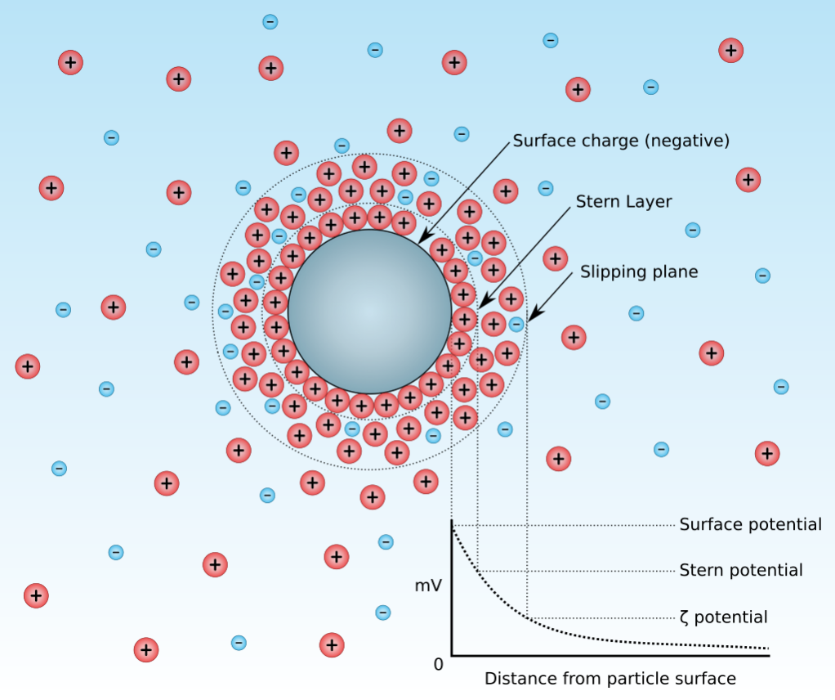
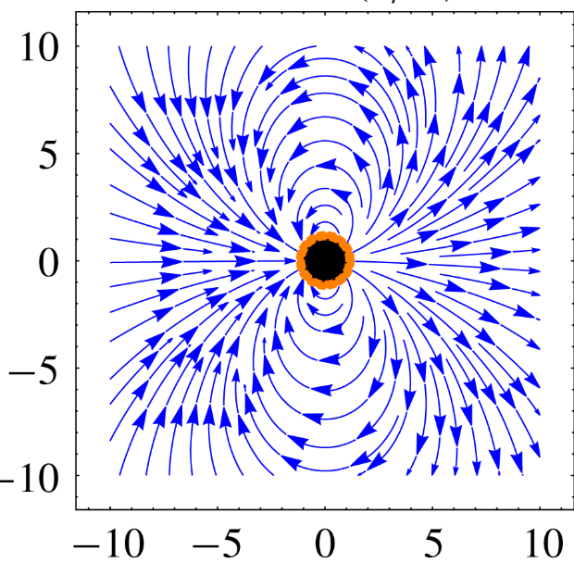
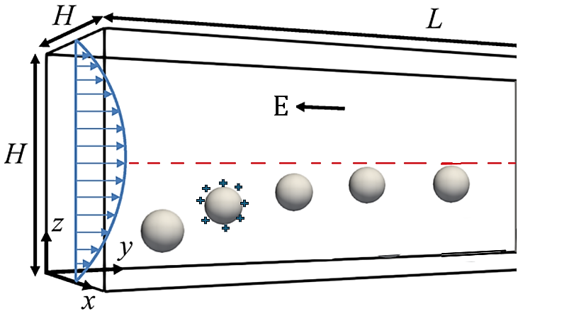
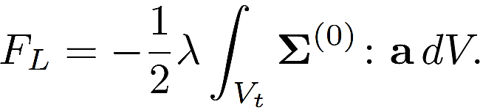
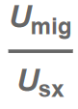
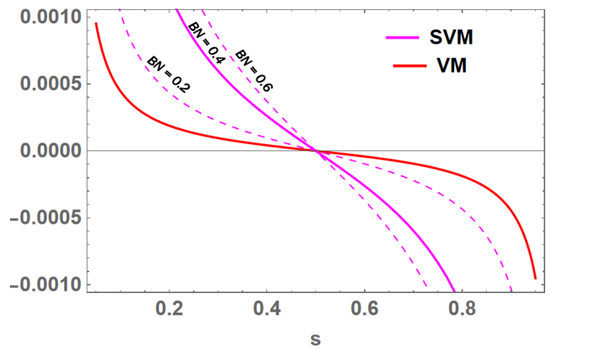
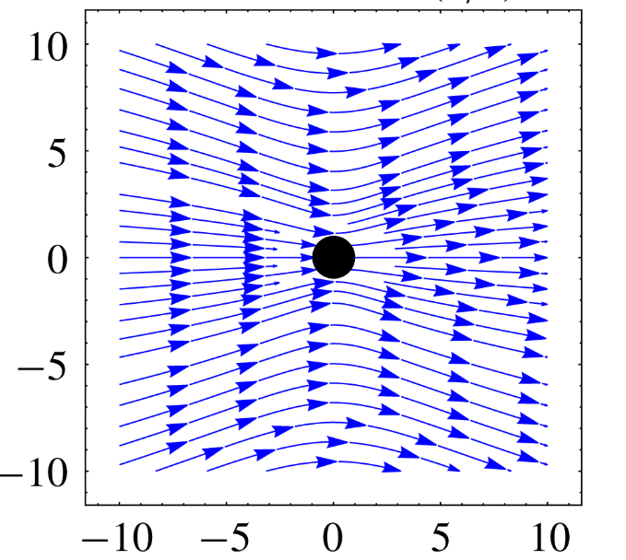
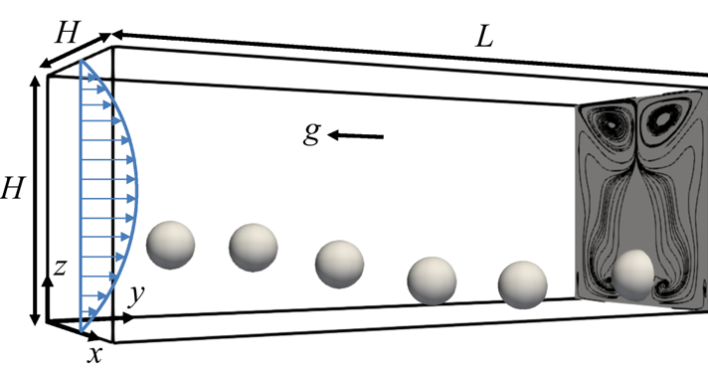
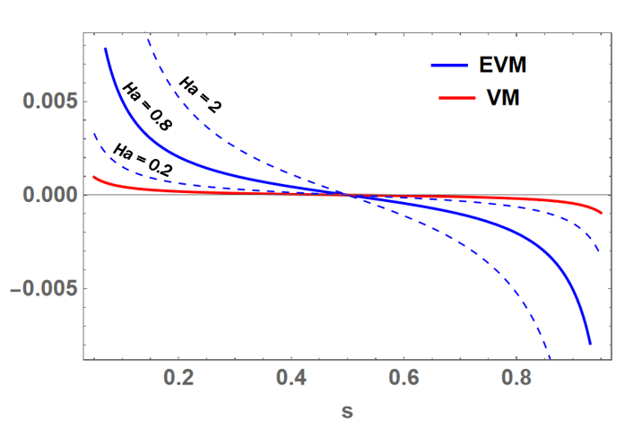
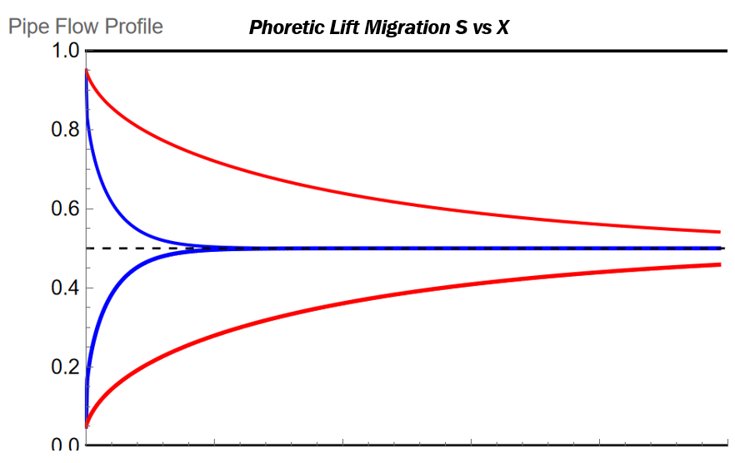
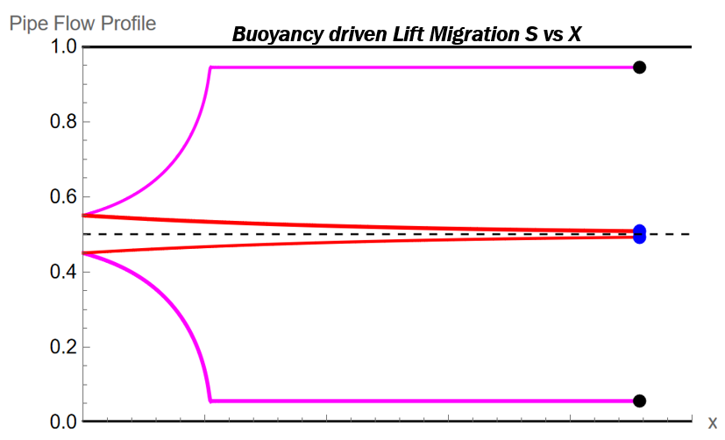
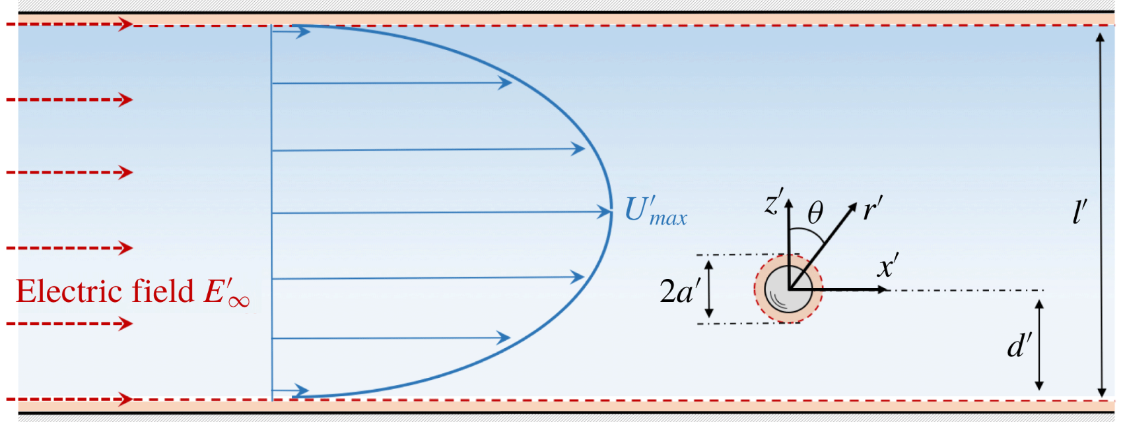
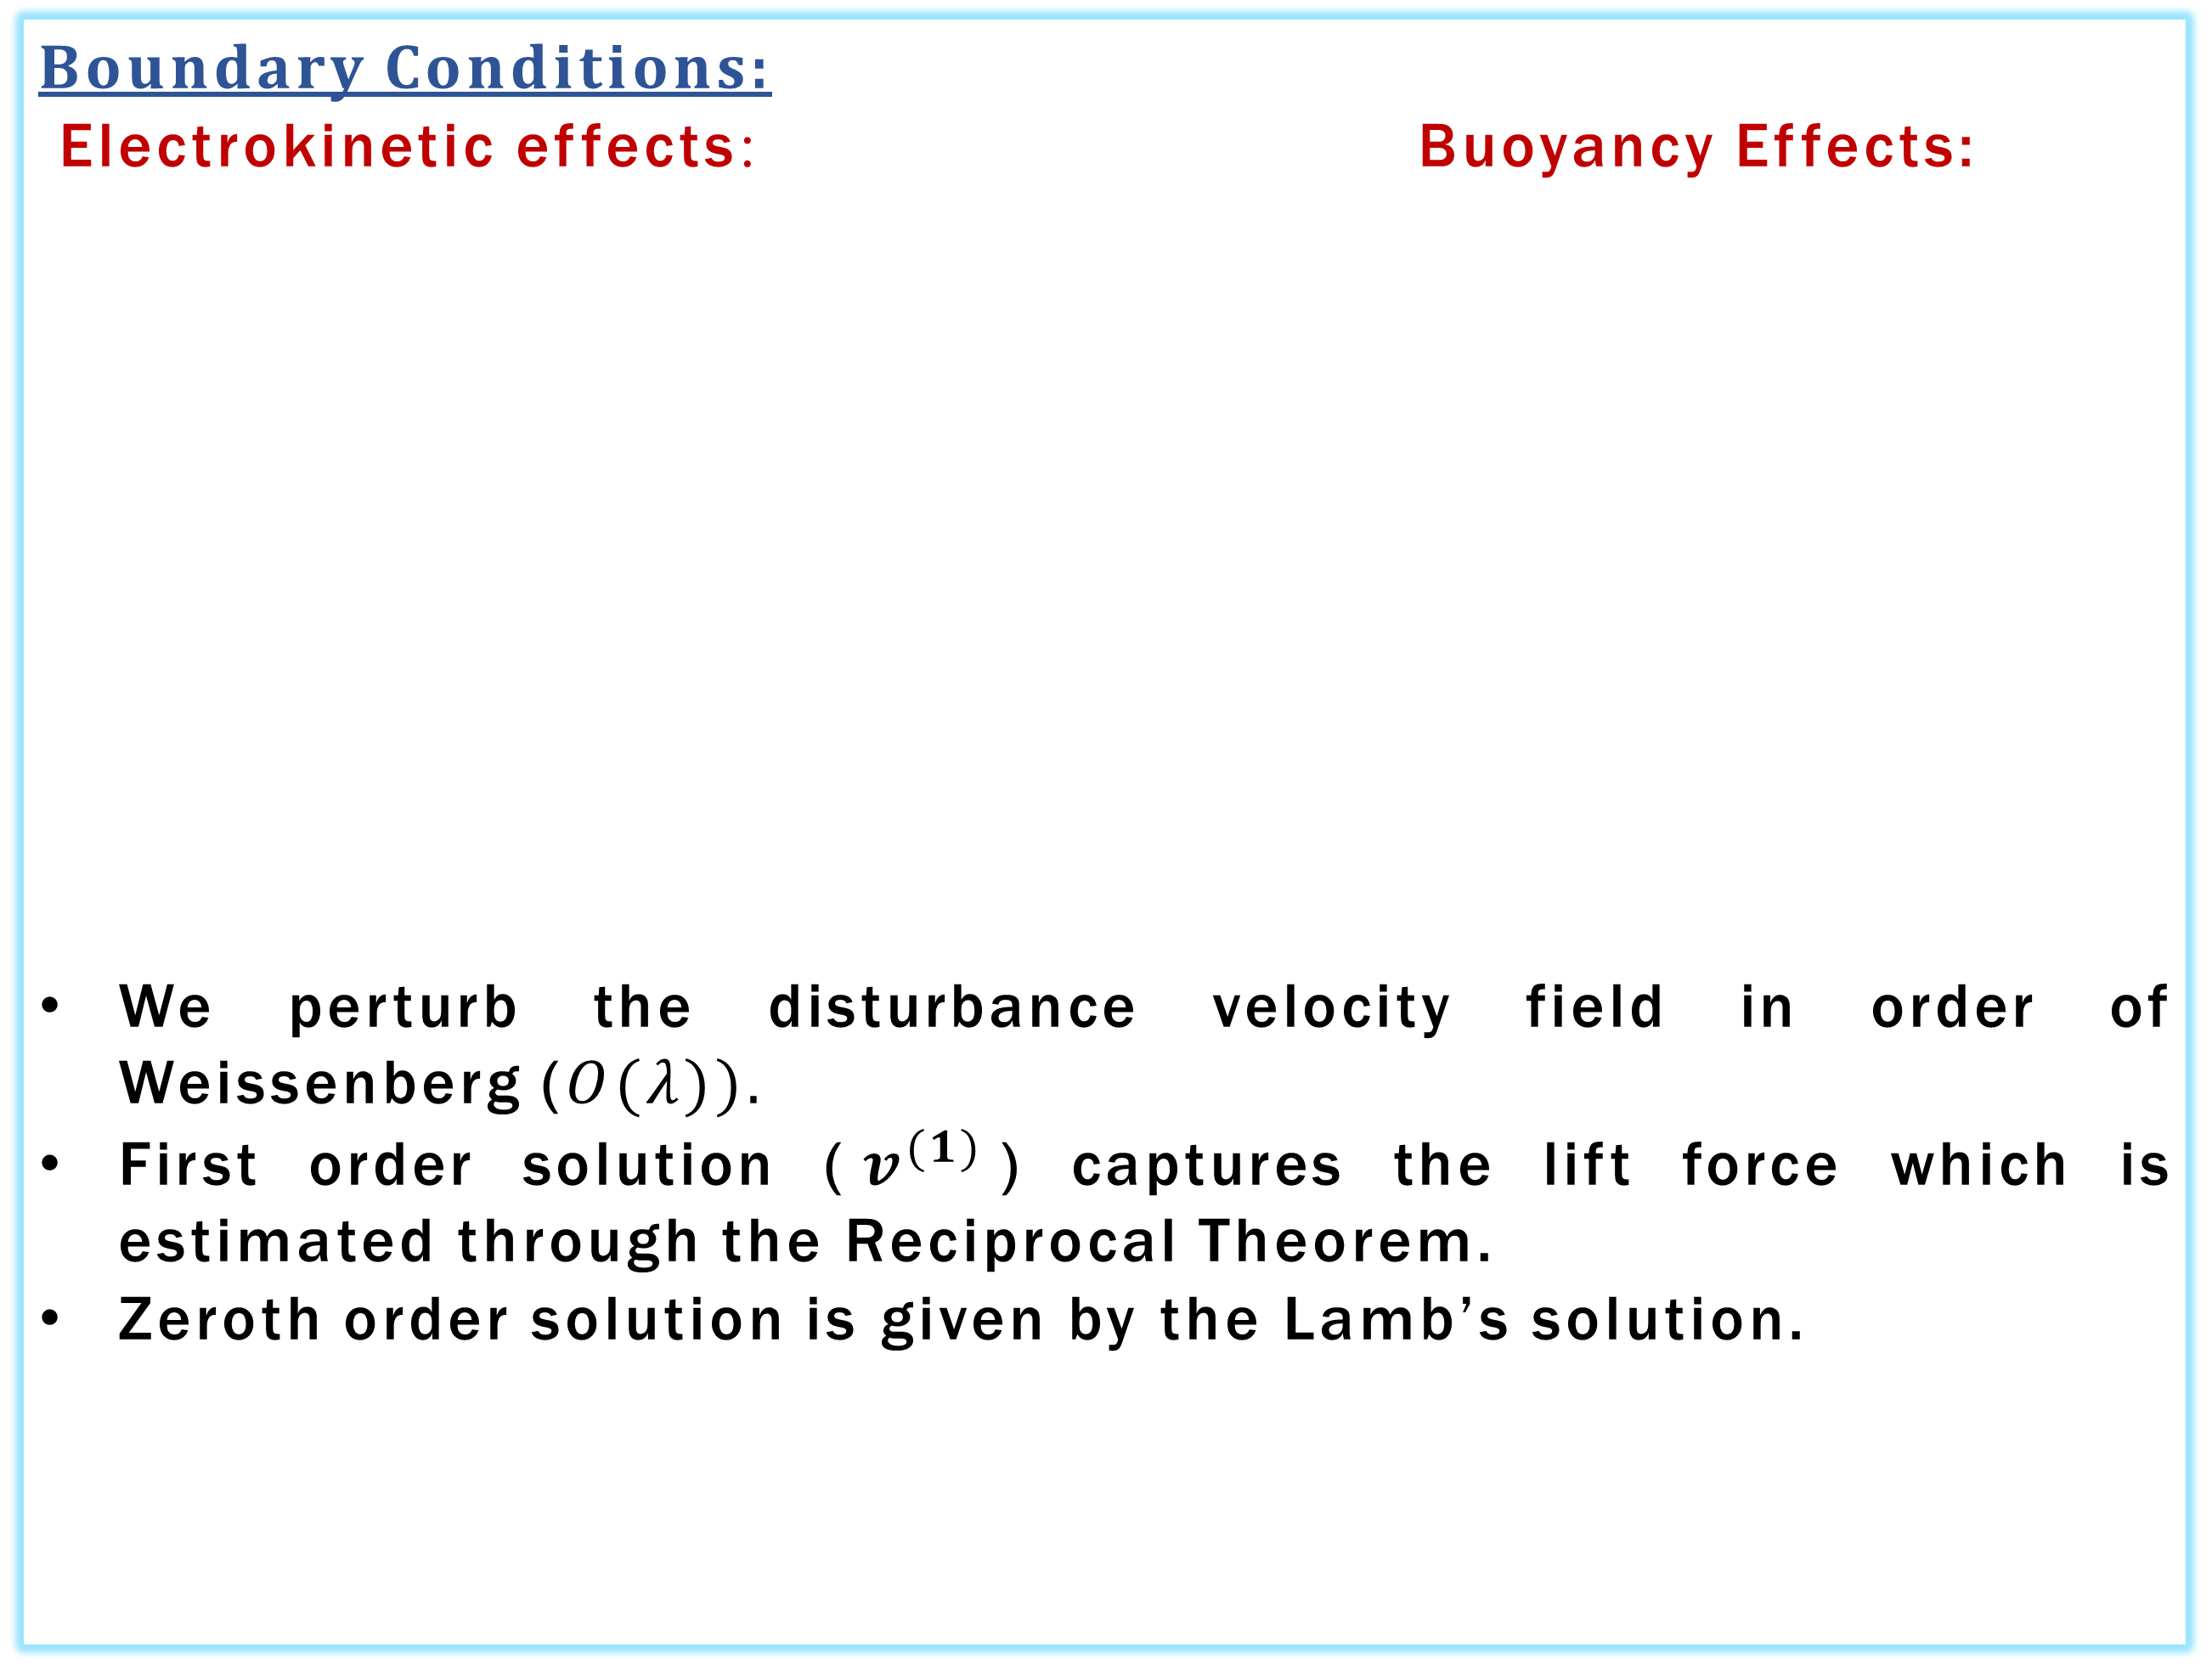
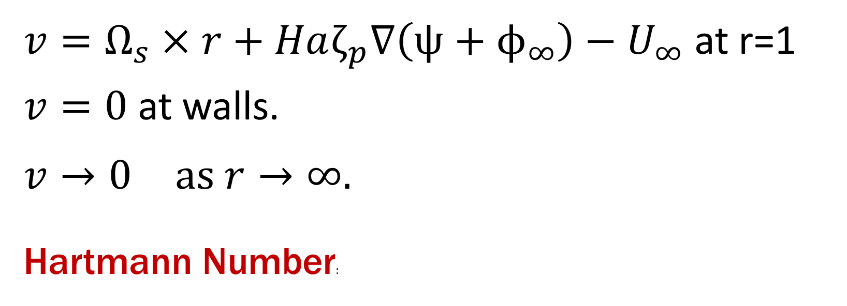
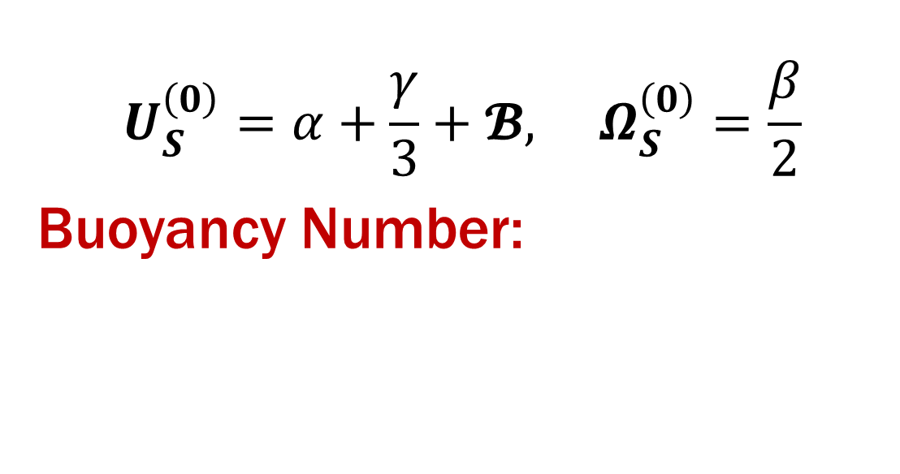
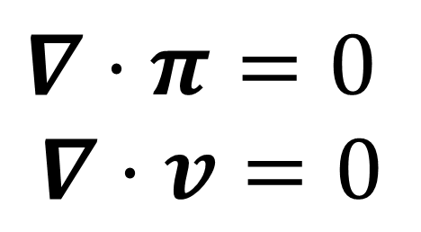
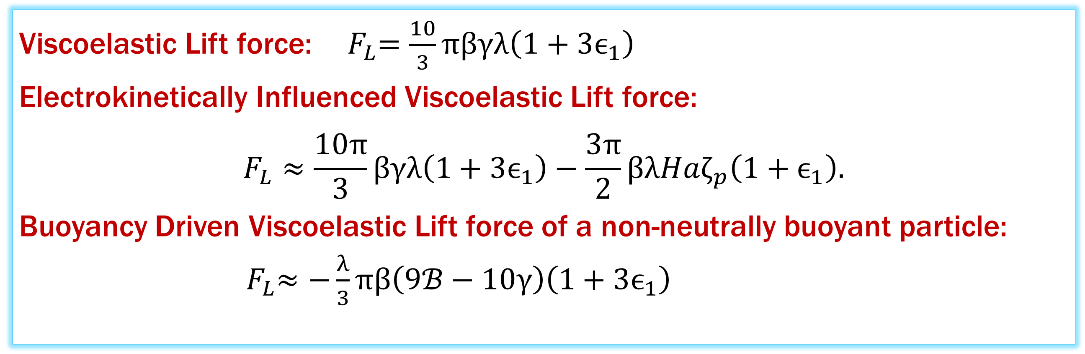
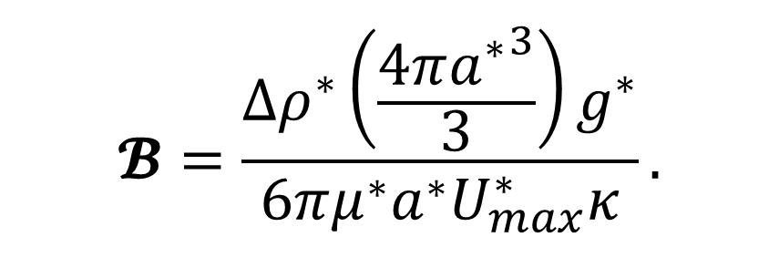

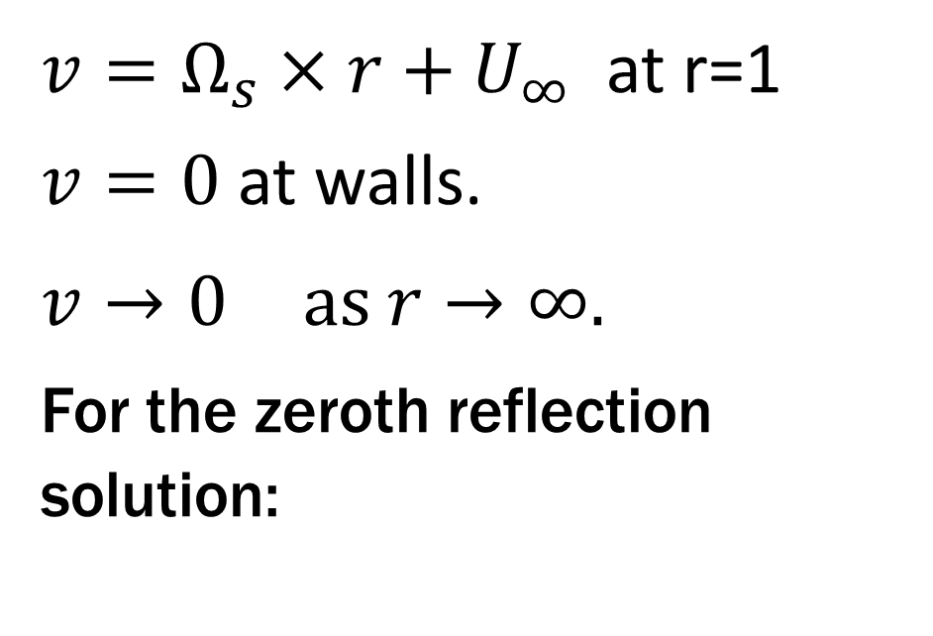
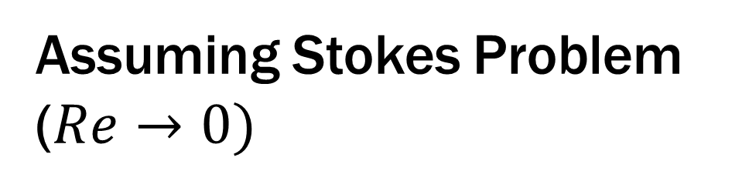
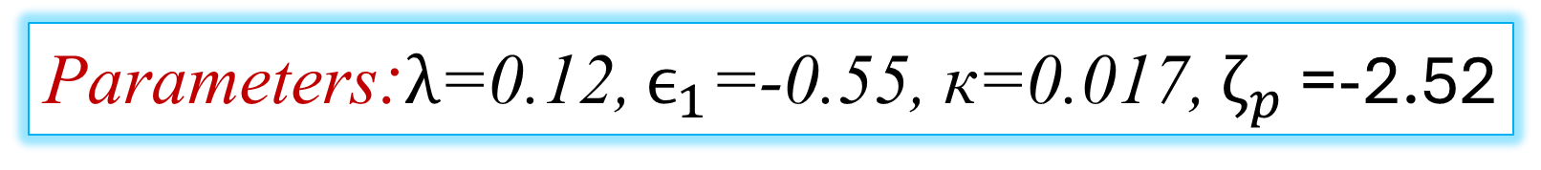
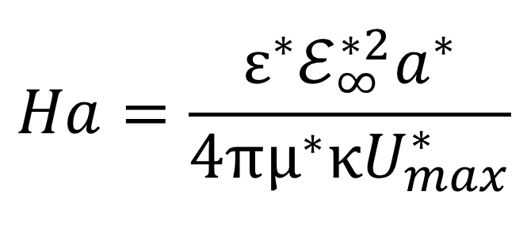
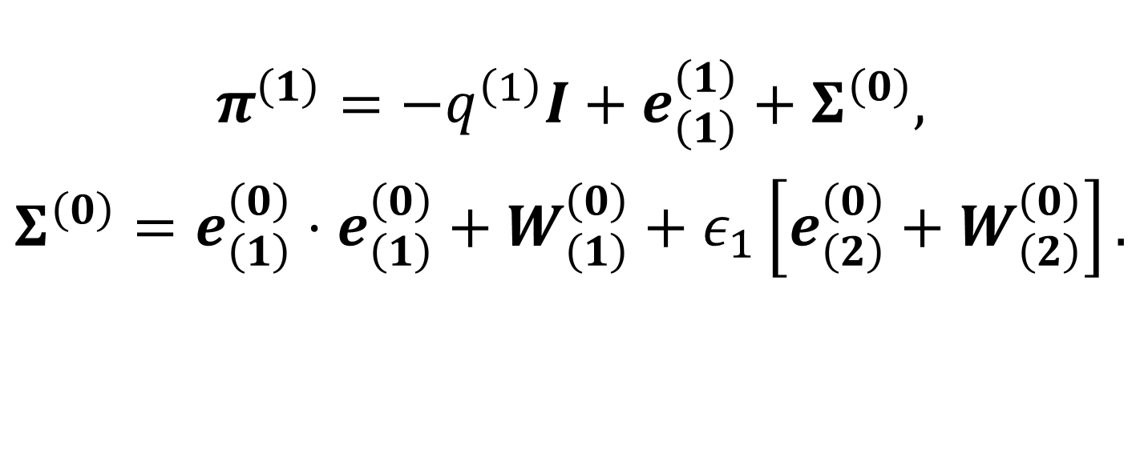
How Force- and Force-free fields influence cross-stream particle migration in complex flows
Soumyo Deep Chowdhury, Akash Choudhary
Department of Chemical Engineering, Indian Institute of Technology Kanpur, India
Force vs Force-free Mechanisms
Solution Techniques
Force-free field (Electrophoresis):
Electrical Double Layer: When a particle is immersed in an electrolytic medium, a thin diffuse layer of counter ions is formed which is called the EDL.
Force field (Gravitation):
When particles sediment under the action of direct gravitational field, their hydrodynamics signature is Stokeslet (~1/r)
Boundary Conditions:
Electrokinetic effects: Buoyancy Effects:
We perturb the disturbance velocity field in order of Weissenberg ($O(λ)).$
First order solution ($v^{(1)}$) captures the lift force which is estimated through the Reciprocal Theorem.
Zeroth order solution is given by the Lamb’s solution.
$v=Ω_{s}×r+Haζ_{p}∇\left(ψ+ϕ_{∞}\right)−U_{∞}$ at r=1
$v=0$ at walls.
$v→0 \text{as} r→∞.$
Hartmann Number:
$v=Ω_{s}×r+U_{∞}$ at r=1
$v=0$ at walls.
$v→0 \text{as} r→∞.$
For the zeroth reflection solution:
Electrophoresis: When an external field is applied in these systems, the diffuse layer then slips resulting in force free motion of the particle known as Electrophoresis.
$$Ha=\frac{ε^{∗}ℰ_{∞}^{∗2}a^{∗}}{4πμ^{∗}κU_{max}^{∗}}$$
$$U_{S}^{\left(0\right)}=α+\frac{γ}{3}+𝓑, Ω_{S}^{\left(0\right)}=\frac{β}{2}$$
Buoyancy Number:
$$𝓑=\frac{Δρ^{∗}\left(\frac{4π{a^{∗}}^{3}}{3}\right)g^{∗}}{6πμ^{∗}a^{∗}U_{max}^{∗}κ}.$$
This motion is characterized by a rapidly decaying source-dipole field with O($1/{r^{3}}$).
$$π^{\left(1\right)}=−q^{\left(1\right)}I+e_{\left(1\right)}^{\left(1\right)}+Σ^{\left(0\right)},$$
$$Σ^{\left(0\right)}=e_{\left(1\right)}^{\left(0\right)}⋅e_{\left(1\right)}^{\left(0\right)}+W_{\left(1\right)}^{\left(0\right)}+ε_{1}\left[e_{\left(2\right)}^{\left(0\right)}+W_{\left(2\right)}^{\left(0\right)}\right].$$
Results
Viscoelastic Lift force: ${ F}_{L}=\frac{10}{3}πβγλ\left(1+3ϵ_{1}\right)$
Electrokinetically Influenced Viscoelastic Lift force:
$$F_{L}≈\frac{10π}{3}βγλ\left(1+3ϵ_{1}\right)−\frac{3π}{2}βλHaζ_{p}\left(1+ϵ_{1}\right).$$
Buoyancy Driven Viscoelastic Lift force of a non-neutrally buoyant particle: ${ F}_{L}≈−\frac{λ}{3}πβ\left(9ℬ−10γ\right)\left(1+3ϵ_{1}\right)$
Objectives
To evaluate the lift force of a particle in Second-Order Fluid.
How does this lift gets affected by flow-aligned force-free field?
How does this lift compare with that of an external forced technique (Buoyancy-induced lift)?
Parameters:$λ$=0.12, $ϵ_{1}$=-0.55, к=0.017, $ζ_{p}$ =-2.52
Conclusions
Problem Formulation
Lifts of these two fundamentally different mechanism are opposite to each other.
Assuming Stokes Problem ($Re→0)$
$$∇⋅π=0$$
$$∇⋅v=0$$
$$π=−qI+e_{\left(1\right)}+λ\left[e_{\left(1\right)}⋅e_{\left(1\right)}+W_{\left(1\right)}\right]+λϵ_{1}\left[e_{\left(2\right)}+W_{\left(2\right)}\right]$$
References: [1.] Choudhary A, Pushpavanam S ,.JFM.2019.479, [2.]Choudhary A, Renganathan T, Pushpavanam S.JFM.2020.397 [3.] Ho, B.P. and Leal, L.G., 1976. JFM

